Slide 1

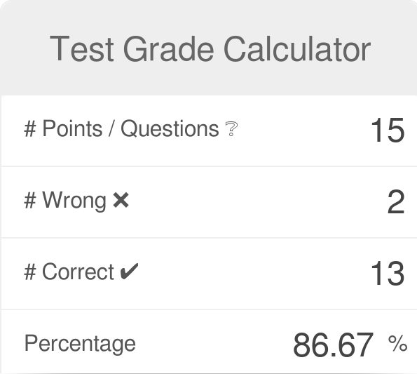

Flask Grade Calculator
An easy-to-use grade calculator that computes quiz, test, and project grades!
Coded by Reed Tumlin

